Slide 1
Ch.16 Preprocessing and Multisource Files

Slide 2

What you will learn in this chapter
Learn about preprocessing and other important topics .
Preprocessing directives
Split compilation
Command line parameters
How to debug

Slide 3
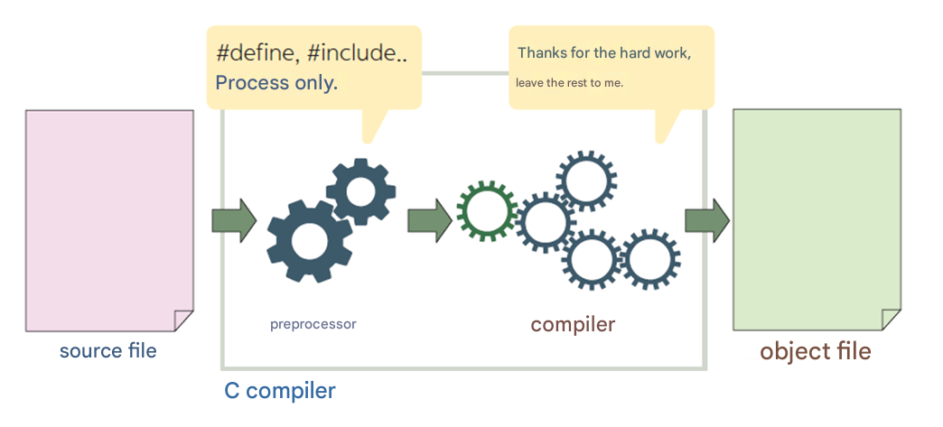
What is a preprocessor ?
A preprocessor is a part of a compiler that processes source files before compilation.

Slide 4
Summary of the preprocessor
Directive | meaning
#define | Macro definition
#include | Including files
#undef | Undefine a macro
#if | If the condition is true
#else | If the condition is false
#endif | End of conditional processing statement
#ifdef | If a macro is defined
#ifndef | If the macro is not defined
#line | Print
#pragma | Meaning varies depending on the system

Slide 5
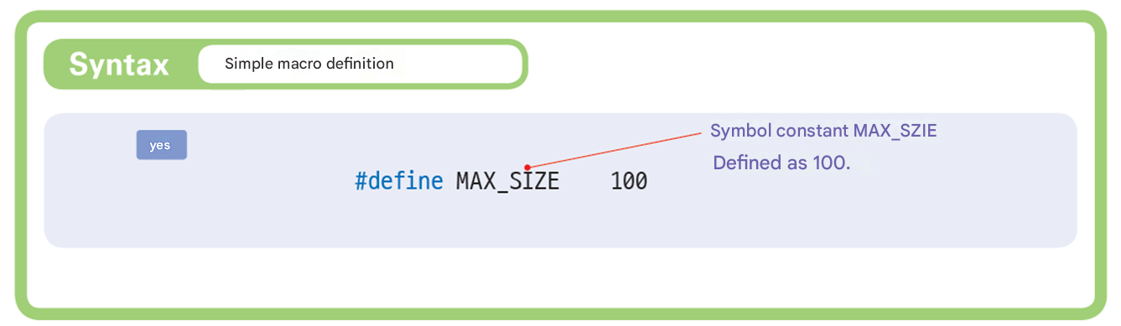

Simple Macro

Slide 6
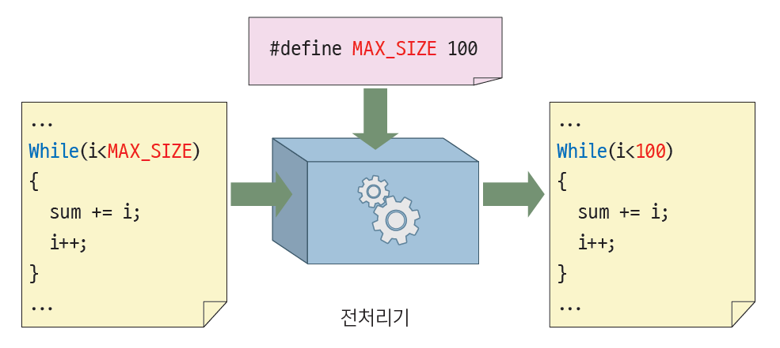
Simple Macro
Preprocessor

Slide 7
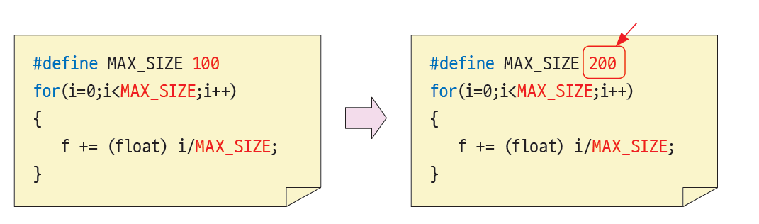
Advantages of Simple Macros
Improves the readability of the program .
It is easy to change constants .

Slide 8
Example of a simple macro
#define PI 3.141592 // pi
#define EOF (-1) // End of file indicator
#define EPS 1.0e-9 // Calculation limit for real numbers
#define DIGITS "0123456789" // Define character constants
#define BRACKET "(){}[]" // Define character constants
#define getchar () getc (stdin) // defined in
#define putchar () putc ( stdout ) // defined in

Slide 9
Example
Let's try using the #define directive to change the operator && to AND .
int i = 0;
while ( i < n AND list[ i ] != key )
i ++;
if ( i IS n )
return -1;
else
return i ;
How should I define a preprocessor ?

Slide 10
Example
#include < stdio.h >
#define AND &&
#define OR ||
#define NOT !
#define IS ==
#define ISNOT !=
int search( int list[], int n, int key)
{
int i = 0;
while ( i < n AND list[ i ] != key )
i ++;
if ( i IS n )
return -1;
else
return i ;
}

Slide 11

Example
int main( void )
{
int m[] = { 1, 2, 3, 4, 5, 6, 7 };
printf ( " Position of 5 in array =%d\n" , search(m, sizeof (m) / sizeof (m[0]), 5));
return 0;
}
Position of 5 in array = 4

Slide 12
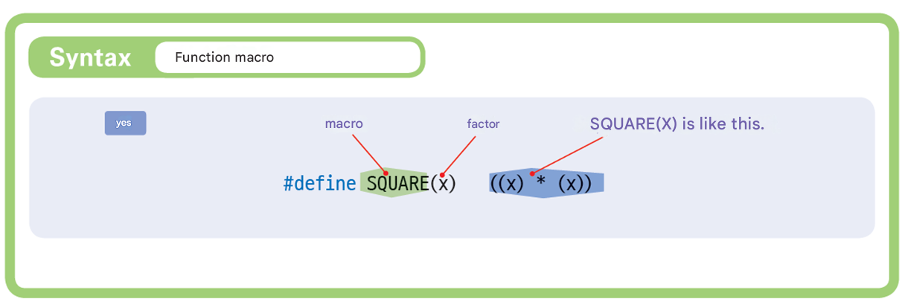
Function Macro
A function -like macro is a macro that has parameters like a function.

Slide 13
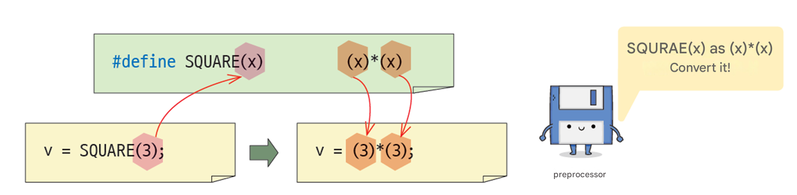
Function Macro

Slide 14
Example of a function macro
#define SUM (x, y) ((x) + (y))
#define AVERAGE (x, y, z) (( (x) + (y) + (z) ) / 3 )
#define MAX (x,y) ( (x) > (y) ) ? (x) : (y)
#define MIN (x,y) ( (x) < (y) ) ? (x) : (y)

Slide 15
Things to note
#define SQUARE(x) x*x // DANGER !!
v = SQUARE( a+b );
v = a + b*a + b;
In function macros, it is a good idea to surround parameters with parentheses .
#define SQUARE(x) (x)*(x) // Correct form

Slide 16
Pros and Cons of Function Macros
Pros and Cons of Function Macros
It is fast to execute because there is no need for a function call step.
The length of the source code increases .
Simple functions use macros
#define MIN(x, y) ((x) < (y) ? (x) : (y))
How to extend a macro beyond one line
#define PRINT(x) if( debug==1 && \
mode==1 ) \
printf (“%d”, x);

Slide 17
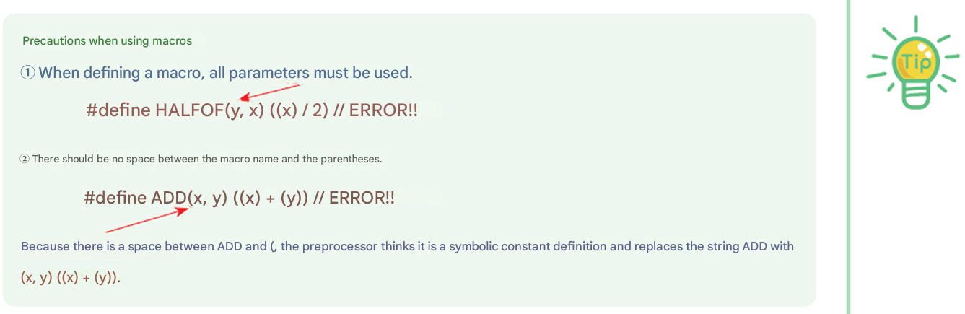
Things to note

Slide 18
Example #1
// Macro Example
#include < stdio.h >
#define SQUARE(x) ((x) * (x))
int main( void )
{
int x = 2;
printf ( "%d\n" , SQUARE(x));
printf ( "%d\n" , SQUARE(3));
printf ( "%f\n" , SQUARE(1.2)); // Even if real number can be applied
printf ( "%d\n" , SQUARE(x+3));
printf ( "%d\n" , 100/SQUARE(x));
printf ( "%d\n" , SQUARE(++x)); // Logic error
return 0;
}
4
9
1.440000
25
25
16

Slide 19
Built-in macros
Built-in macros : predefined macros
Built-in macros | explanation
__DATE__ | When this macro is encountered, it is replaced with the current date ( month day year ) .
__TIME__ | When this macro is encountered, it is replaced with the current time ( hour : minute : second ) .
__LINE__ | When this macro is encountered, it is replaced with the current line number in the source file .
__FILE__ | When this macro is encountered, it is replaced with the source file name .
printf("Compile date =%s\n" , __DATE__ );
printf("Fatal error occurred File name = %s Line number = %d\n" , __FILE__ , __LINE__ );
Compile Date = Aug 23 2021
Fatal error occurred File name =C:\Users\kim\source\repos\Project14\Project14\ source .c Line number = 6

Slide 20
Lab: ASSERT Macro
ASSERT macro that is frequently used when debugging programs.
Assuming (sum == 0) this source file C:\Users\chun\source\repos\Project21\Project21\macro4.c
Failed at line 12 .

Slide 21
Example : ASSERT Macro
#include < stdio.h >
#define ASSERT( exp ) { if (!( exp )) \
{ printf("Assumption("# exp") source file %s % dth line failed.\n"\
,__FILE__, __LINE__), exit(1);}}
int main( void )
{
int sum=100; // The initial value of local variable's is not 0
ASSERT(sum == 0); // sum should be 0
return 0;
}
Used to extend a macro to the next line
Assuming (sum == 0) this source file c:\user\igchun\documents\visual studio 2017\projects
Failed at line 12

Slide 22
Function Macros and Functions
The advantage is that function macros are faster to execute than functions. Since macros are not called but rather code is inserted at that location, there is no need to go through the complicated steps of a function call.
The length of the code cannot be longer than a certain limit. In many cases, the limit is one or two or three lines.
Using macros increases the size of your source files.

Slide 23
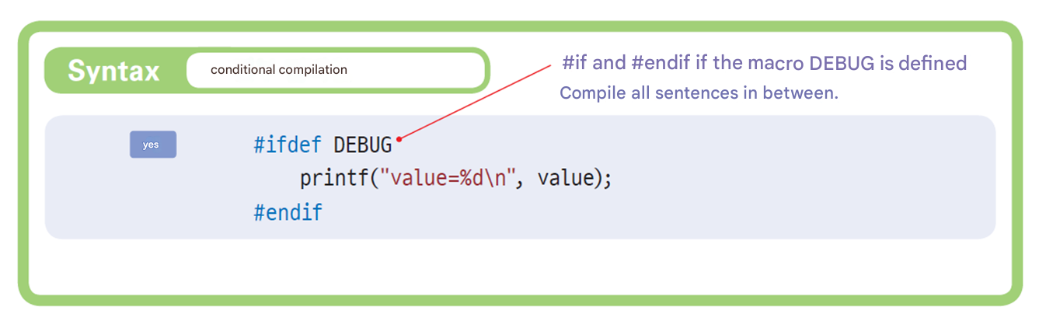
#ifdef

Slide 24
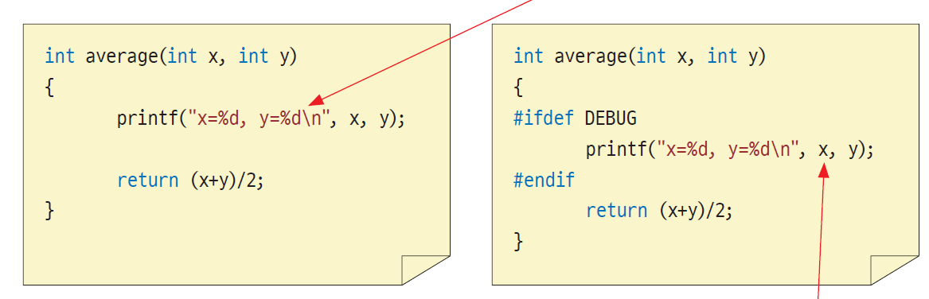
Example of #ifdef
Include output statements only when DEBUG is declared .

Slide 25
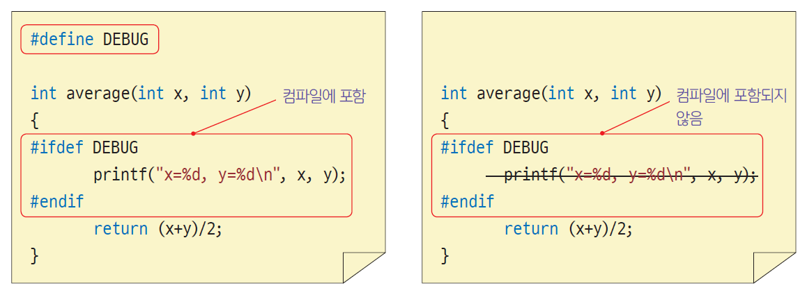
Macro declaration location

Slide 26
Lab: Separate Linux and Windows versions
For example, let's say a company develops a program for Linux and Windows.
This is the Linux version .

Slide 27
Example
#include < stdio.h >
#define LINUX
int main( void )
{
# ifdef LINUX
printf (“ This is the Linux version . \n”);
#else
printf (“ Windows version . \n”);
# endif
return 0;
}
LINUX version
WINDOWS VERSION

Slide 28
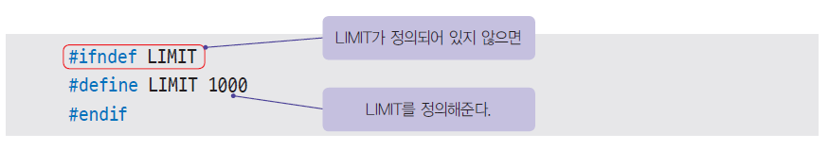
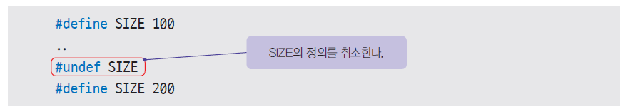
# ifndef , # undef
# ifndef
If a macro is not defined, it is included in the compilation .
# undef
Cancels the definition of a macro .

Slide 29
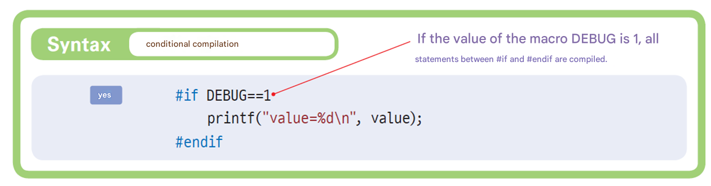
#if
Compile if symbol evaluates to true
Conditions must be constants and can use logical and relational operators.

Slide 30
#if-#else-#endif
#define NATION 1
#if NATION == 1
printf ( " Hello ?" );
#elif NATION == 2
printf ( " Are you okay ?" );
#else
printf ( "Hello World!" );
#endif

Slide 31
Various examples
#if (AUTHOR == KIM) // Possible !! KIM is another macro
#if (VERSION*10 > 500 && LEVEL == BASIC) // Possible !!
#if (VERSION > 3.0) // ERROR !! The version number is displayed as an integer
#if (AUTHOR == "CHULSOO" ) // ERROR !!

Slide 32
Comment out multiple lines
#if 0 // Start from here
void test()
{
/* If there is a comment here, it is not easy to comment out the entire code . */
sub();
}
# endif // Up to here, it is commented out .

Slide 33
Example
Choose a sorting algorithm
#define SORT_METHOD 3
#if (SORT_METHOD == 1)
... // Implementation of selection sort
#elif (SORT_METHOD == 2)
... // Bubble sort implementation
#else
... // Quick sort implementation
#endif

Slide 34
Multiple source files
Single source file
The file size is too large .
Difficult to reuse source files
Multiple source files
You can collect only related codes into a single source file.
Easy to reuse source files

Slide 35
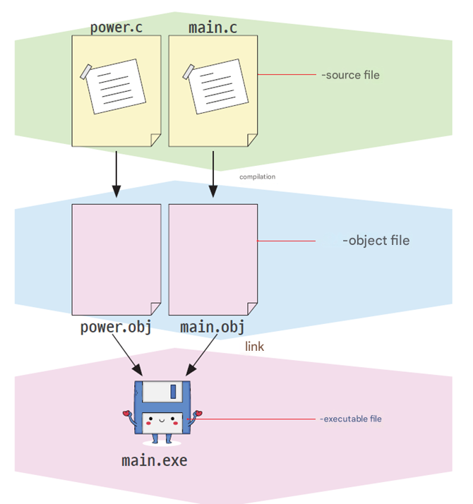
Multiple source files

Slide 36
Example :
power() that calculates the power and save it in power.c Then, main.c create a function and define the main() function in it, then call power() from main() .
Enter the value of x : 2
Enter the value of y : 3
2 to the cube is 8.00 .

Slide 37
Example
// main.c
#include < stdio.h >
#include " power.h "
int main( void )
{
int x, y;
printf ( " Enter the value of x : " );
scanf ( "%d" , &x);
printf ( " Enter the value of y : " );
scanf ( "%d" , &y);
printf ( " The power of % d of %d is %f\n" , x, y, power(x, y));
return 0;
}

Slide 38
Example
// power.c
#include " power.h "
double power( int x , int y )
{
double result = 1.0; // Initial value is 1.0
int i ;
for (i = 0; i < y ; i++)
result *= x ;
return result;
}

Slide 39
Example
#pragma once
// power. h
double power( int x , int y ); // Function prototype definition

Slide 40
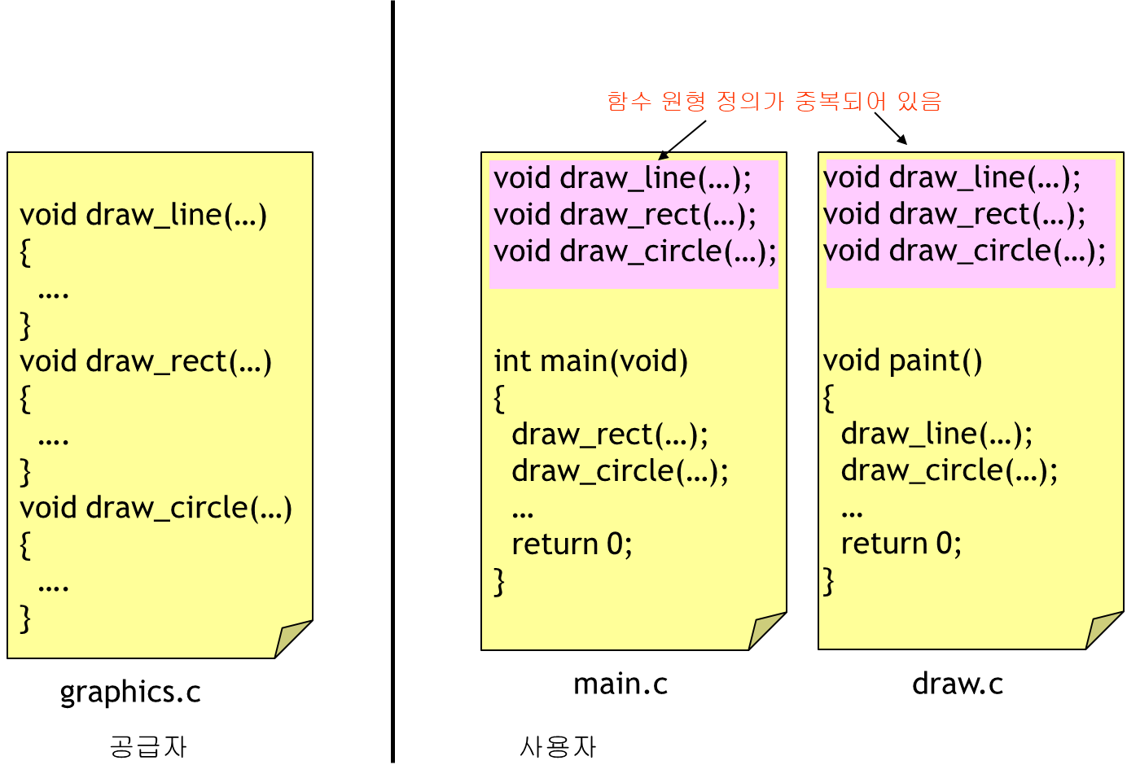
If you don't use header files

Slide 41
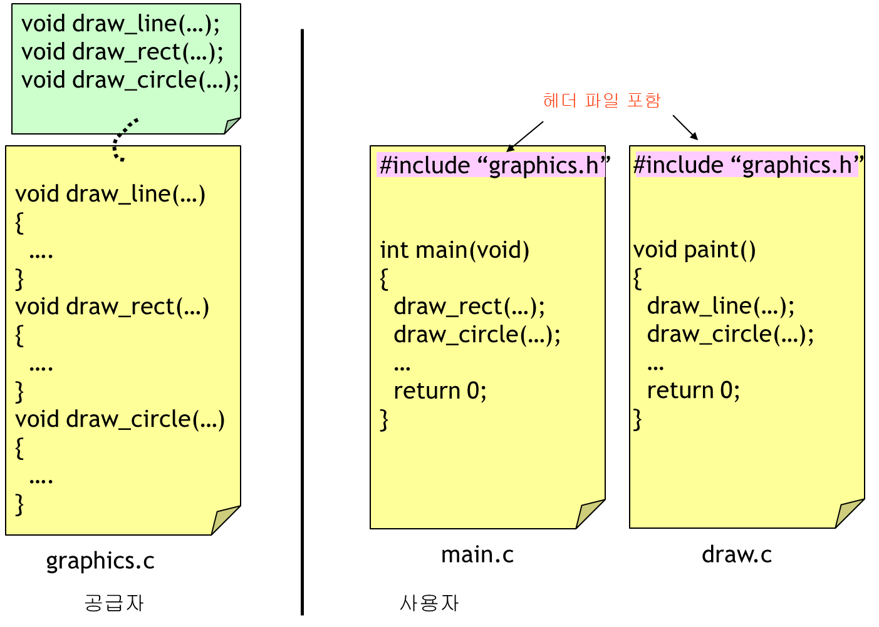
Using header files

Slide 42
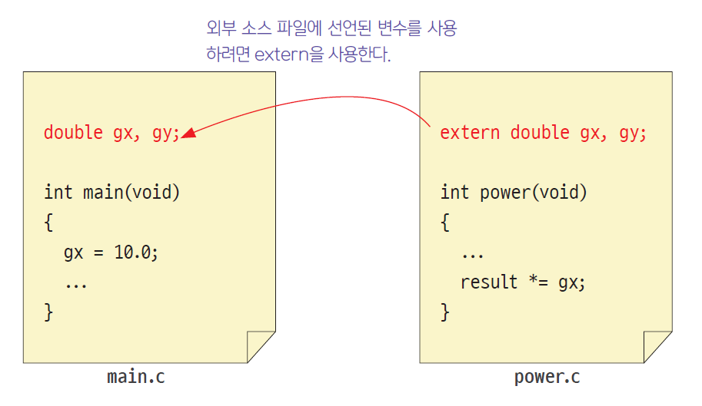
External variables in multiple source files
Use variables declared in external source files
To do this, use extern.

Slide 43
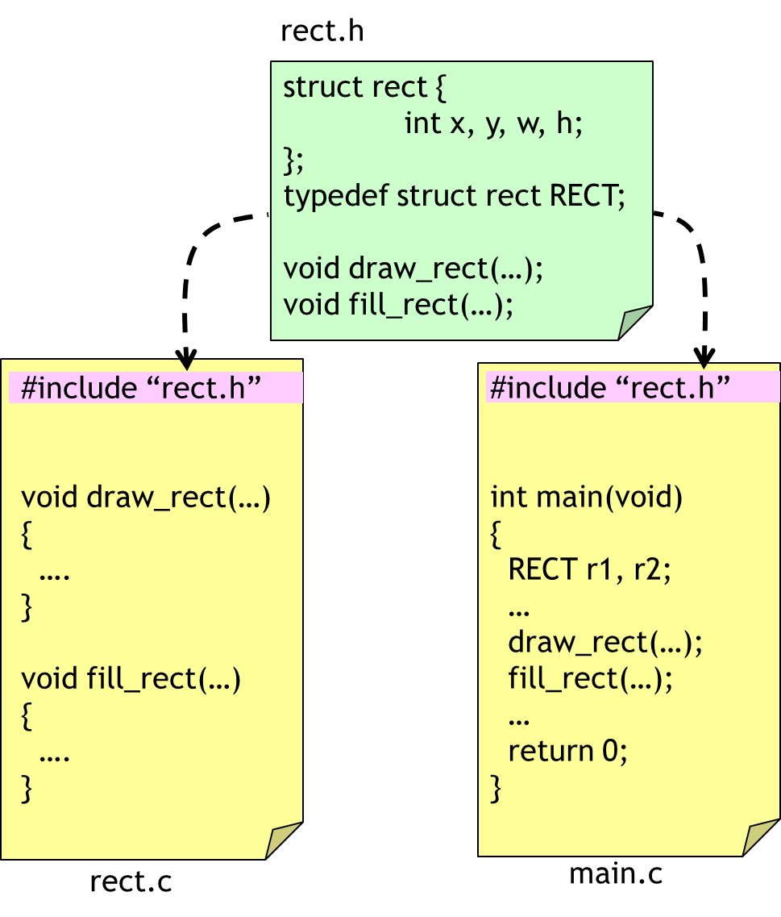
Example
Let's write the following program with multiple sources .

Slide 44
rect.h
#pragma once
struct rect {
int x, y, w, h;
};
typedef struct rect RECT ;
void draw_rect ( const RECT *);
double calc_area ( const RECT *);
void move_rect ( RECT *, int , int );

Slide 45
rect.c 1/2
#include < stdio.h >
#include " rect.h "
#define DEBUG
void draw_rect ( const RECT * r )
{
#ifdef DEBUG
printf( "draw_ rect (x=%d, y=%d, w=%d, h=%d) \n" , r ->x, r ->y, r ->w, r ->h);
#endif
}

Slide 46
rect.c 2/2
double calc_area ( const RECT * r )
{
double area;
area = r ->w * r ->h;
#ifdef DEBUG
printf ( " calc_area ()=%f \n" , area);
#endif
return area;
}
void move_rect ( RECT * r , int dx , int dy )
{
#ifdef DEBUG
printf ( " move_rect (%d, %d) \n" , dx , dy );
#endif
r ->x += dx ;
r ->y += dy ;
}

Slide 47
main.c
#include < stdio.h >
#include " rect.h "
int main( void )
{
RECT r = { 10,10, 20, 20 };
double area = 0.0;
draw_rect (&r);
move_rect (&r, 10, 20);
draw_rect (&r);
area = calc_area (&r);
draw_rect (&r);
return 0;
}

Slide 48
Execution results
draw_rect (x=10, y=10, w=20, h=20)
move_rect (10, 20)
draw_rect (x=20, y=30, w=20, h=20)
calc_area ()=400.00
draw_rect (x=20, y=30, w=20, h=20)

Slide 49
Lab: Header file Duplicate blocking
a header file containing a structure definition twice in your source file, you will get a compilation error. To prevent this, use #ifndef You can use directives
#ifndef STUDENT_H
#define STUDENT_H
struct STUDENT {
int number;
char name[10];
};
#endif
sauce No compilation errors even if included multiple times in a file

Slide 50
TIP
recent C languages, you can achieve the same effect by adding the following statement to the beginning of the header file. When you add a header file in Visual Studio, it is automatically added to the beginning.
#pragma once

Slide 51

Midterm Inspection
Tell the following sentences true or false. “ It is advantageous to create a single source file rather than using multiple source files in many ways .”
Let's create a source file and related header file that contain a function to find the factorial.
Let's create a header file that defines a point structure, which represents a point in two-dimensional space.

Slide 52
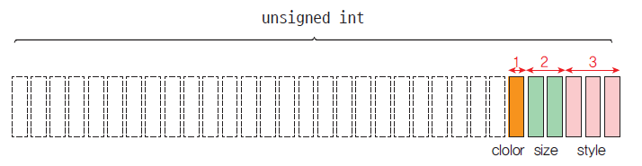
Bit field structure
A structure whose members are divided into bit units.
struct Tag name {
Data type member name 1: bit count ;
Data type member name 2: bit count ;
...
};
struct product {
unsigned style : 3;
unsigned size : 2;
unsigned color : 1;
};

Slide 53
bit_field.c
// Bit field structure
#include < stdio.h >
struct product {
unsigned style : 3;
unsigned size : 2;
unsigned color : 1;
};
int main( void )
{
struct product p1;
p1.style = 5;
p1.size = 3;
p1.color = 1;
printf ( "style=%d size=%d color=%d\n" , p1.style, p1.size, p1.color);
printf ( " sizeof (p1)=%d\n" , sizeof (p1));
printf ( "p1=%x\n" , p1);
return 0;
}
style=5 size=3 color=1
sizeof (p1)=4
p1= ccccccfd

Slide 54
Advantages of bit fields
Memory is saved .
When storing a variable that only has a state of ON or OFF , it saves much memory to use a 1- bit bit field rather than a 32- bit int type variable .

Slide 55
Q & A

